Slide 1
FY21 PROJECTED PROFITABILITY ANALYSIS
LOYOLA UNIVERSITY, NEW ORLEANS

Slide 2
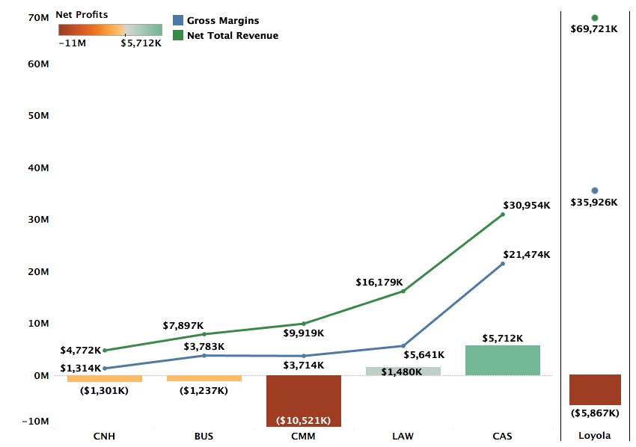
Profitability by College FY21 Projections

Slide 3
Profitability by Department (FY21 Projections)
Excluding Environment
Notes:
Accounting is projected to be positive. All other 14 departments continue to be loss making. – Add the note on Accounting

Slide 4
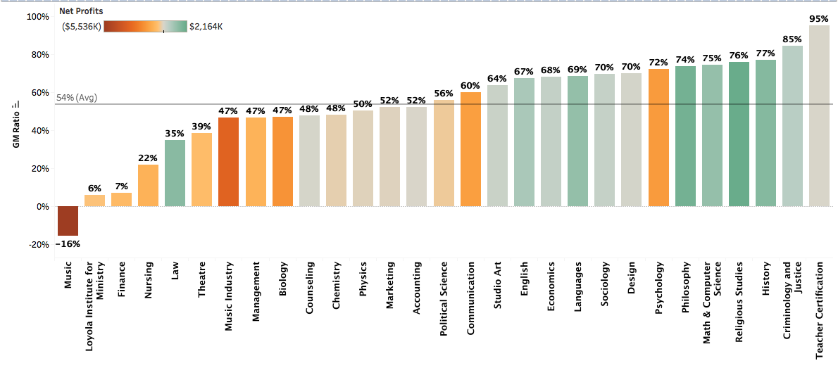
GM to Revenue Ratio by Department (FY21 Projected)
Excluding Environment

Slide 5
DEFINITIONS
Net Total Revenue (NTR): NTR includes revenue for courses taught by the faculty of a department across all three terms, distributed revenue for courses that do not belong to a specific department, and distribution of revenues from courses of programs like Study Abroad that do not have any assigned faculty. Avg. NTR per credit (FY20) for Fall and Spring semesters is $577
Gross Margins (GM): GM = NTR – Direct Costs. Direct costs include salaries, operating costs, and fringe benefits. Avg. GM% for FY20 = 54%
Profitability = GM – Indirect Costs + Indirect Revenues. Indirect costs refer to administration costs, auxiliary costs, or college level costs distributed over departments of the specific college. Indirect revenues include auxiliary revenues, dorm revenues, and revenue from other sources.

Slide 6
Methodology FY21 Projections
FY21 Revenue Projections: Revenue projections are based on Fall 2020 enrollments and projected Spring retention rate. FY20 summer revenues are used as proxy for the FY21 summer term.
Direct Costs: Direct costs include salaries and operating costs from department budgets. FY20 fringe benefits are used as a proxy for FY21 fringe benefits.
Indirect Costs: Indirect costs in FY20 and FY21 have been higher than previous years and is reflected in department-level profitability. FY21 is also estimated to bring in lower Auxiliary revenues.

Slide 7
DEPARTMENTS WITH WORSENING FINANCIAL PERFORMANCE

Slide 8
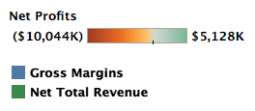
Music
Music has high enrollment but also a historically high discount rate which suppresses their NTR.
Music also has twice the directs costs of an average department which further suppresses their GM% to -16%.
GM% for Music was negative in FY20 due to a steep decline in NTR without proportional cuts in direct costs. The steep decline in NTR was driven by high discount rate as evidenced by NTR/Credit of $387 compared to university average of $577 and is only seeing a slight recovery in FY21.

Slide 9
Music Industry
The NTR/Credit for Music Industry decreased from $698 in FY19 to $519 in FY20 signifying high discount rates as drivers of low revenues, despite increase in # credits from FY19 to FY20
The projected GM for Music Industry is 47% compared to the university average of 54%
Increased auxiliary costs and reduced auxiliary revenues because of COVID-19 add to the projected losses in FY20 but the structural issues of high discount rates that have driven losses historically persist
Notes:
NTR and GM for Music Industry are projected to continue to decline in FY21 because of combination of lower enrollment and higher discount rates – what is the NTR/student by year?

Slide 10
Nursing
Nursing continues to be an expensive program (less than half the GM% than the average department).
However, Gross Margin is expected to decrease more than the projected decrease in NTR (i.e., $770K versus 469K) due to increased direct costs in FY21.
Increased auxiliary costs with lower auxiliary revenues add to the FY20 losses and the projected losses for FY21.

Slide 11
Theatre
The projected GM for Theatre is 39%, 15 percentage points lower than the university average
Theatre’s low GM is being driven high discount rates. NTR/Credit of $471 in FY19 and $425 in FY20 compared to the university average of $594 and $577 in both years respectively
Projected increases in auxiliary costs and simultaneously declining auxiliary revenues because of COVID-19 add to the department’s losses

Slide 12
Psychology
Although Psychology has low direct costs yielding it a 72% GM, it struggles with profitability primarily due the high level of indirect costs that are allocated to the department based on student enrollment.
Their NTR/Credit is only $516 in FY19 and $509 in FY20 compared to the university average of $594 and $577 in both years respectively.

Slide 13
Biology
With almost constant NTR and GM from FY20 to FY21, the increase in projected losses for FY21 are driven by higher auxiliary costs and lower auxiliary revenues.
However, the structural problems of high discount rates from FY19 remain as its 47% GM fails to cover its share of overhead.
Their NTR/Credit is only $491 in FY19 and $462 in FY20 compared to the university average of $594 and $577 in both years respectively.

Slide 14
Communication
Communication had an increase of ~33% in NTR from FY19 to FY20 but is projected to see a ~7% in FY21 due to lower enrollment
GM of 60% is higher than the avg of 54%, but is weighed down by indirect costs given the department’s size
Higher enrollment without a subsequent increase in discount rates and direct costs combined with a return to normal levels of auxiliary costs and revenues should help the department return a profit

Slide 15
DEPARTMENTS WITH IMPROVING FINANCIAL PERFORMANCE

Slide 16
Chemistry
After a drop in GM in FY20, Chemistry’s GM is projected to improve from 35% in FY20 to 48% in FY21 due to higher enrollment better leveraging its fixed direct costs.
However, university-wide structural issues pertaining to high discount rates remain a challenge to achieving profitability.

Slide 17
Political Science
GM has improved from 50% in FY20 to 56% in FY21 driven mainly by higher enrollment and revenues as direct costs have stayed largely constant.
Structural issues with high discount rates across the university continue to ail the department. Lower discount rates will help the department pull in revenue proportionate with its size in terms of enrollment.

Slide 18
Management
Management’s NTR has not changed much from FY19 to FY21’s projection, with fluctuations in profitability primarily driven by changes in Gross Margins each year.
The NTR/Credit for Management decreased from $544 in FY19 to $528 in FY20 signifying higher than average discount rates

Slide 19
Marketing
A healthy enrollment-driven projected increase in NTR for Marketing is likely to reduce the losses for the department to $60K in FY21.
Their NTR/Credit is $569 in FY19 and $525 in FY20 compared to the university average of $594 and $577 in both years respectively.
So higher enrollment is being driven by higher discount rates. The focus of the department should be to continue driving enrollment without further discounts.

Slide 20
Finance
The silver lining of Finance’s low enrollments is that it is allocated a lower share of indirect costs.
However, Finance had a steep decline in NTR in FY20 leading to a big drop in GM from 39% in FY19 to 7% in FY21 due to the largely fixed nature of its direct costs.
Their NTR/Credit declined from $619 in FY19 to $475 in FY20. Without a significant change in # credits taken, the NTR decline is primarily driven by high discount rates.

Slide 21
Loyola Institute for Ministry
Lim is projected to yield a 6% GM in FY21 compared to the university average of 54%.
Given its $491K direct costs, there is a need for much greater enrollment and/or NTR to generate profit even after covering its relatively small share of indirect costs given the small size of the department’s enrollments.

Slide 22
Summary and Recommendations
Higher indirect costs and lower auxiliary revenues because of coronavirus crisis are reflected in losses of all departments.
Outside of the increased auxiliary costs, loss-making departments suffer from performance issues of lower enrollment and structural issues of high direct costs and high discount rates
High discount rates reflect the discounts offered to students taking courses offered by specific departments. These students may or may not be part of the majors offered by the departments. As such, driving lower discount rates should be a university wide initiative.

Slide 23
Summary and Recommendations
For departments with reducing enrollment, a separate analysis to identify the majors driving lower enrollment can be provided at a later date.
Additional analysis that can benchmark proportionate direct costs in relation to enrollment in each department can help improve the GM to Revenue Ratio.
Finally, improvement in auxiliary revenues and reduction in auxiliary costs post-coronavirus will aid the university-wide profitability.

Slide 24
Appendix (FY19 and FY20)

Slide 25
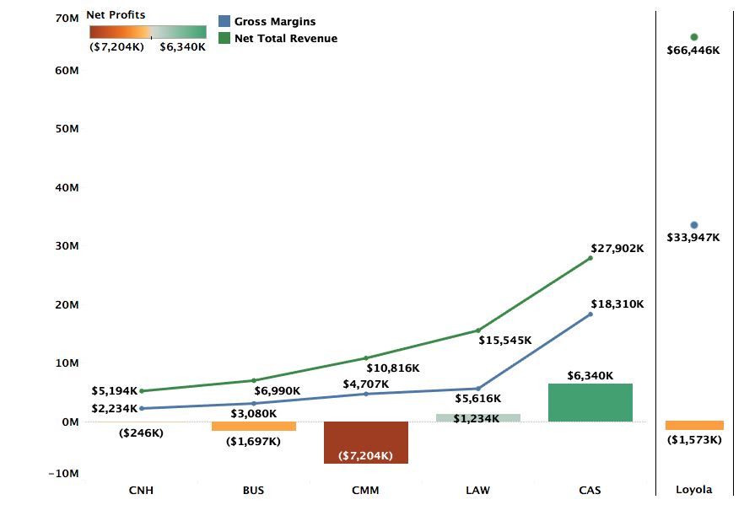
Profitability by College FY20 Actuals

Slide 26
Profitability by Department (FY20 Actuals)
Excluding Environment
Notes:
Departments like Teacher Certification and Studio art are small departments with low costs. They have +ve gross margins but higher profitability largely because of dorm revenue share which is divided by college and within college, the departments get equal share.

Slide 27
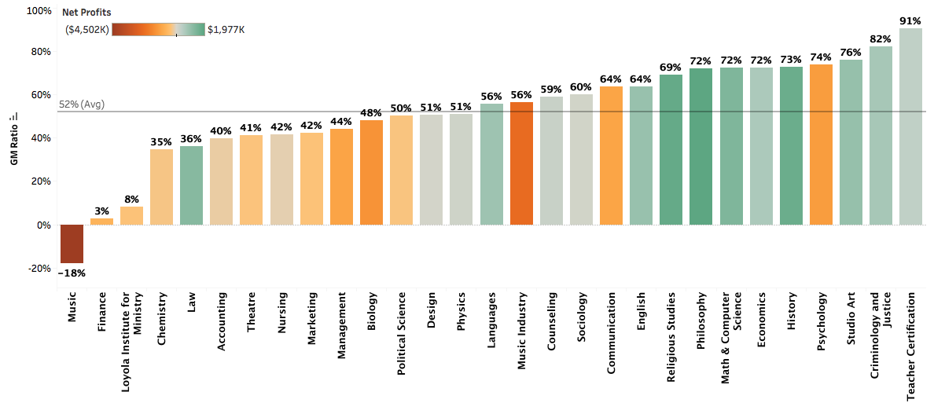
GM to Revenue Ratio by Department (FY20 Actuals)
Excluding Environment

Slide 28
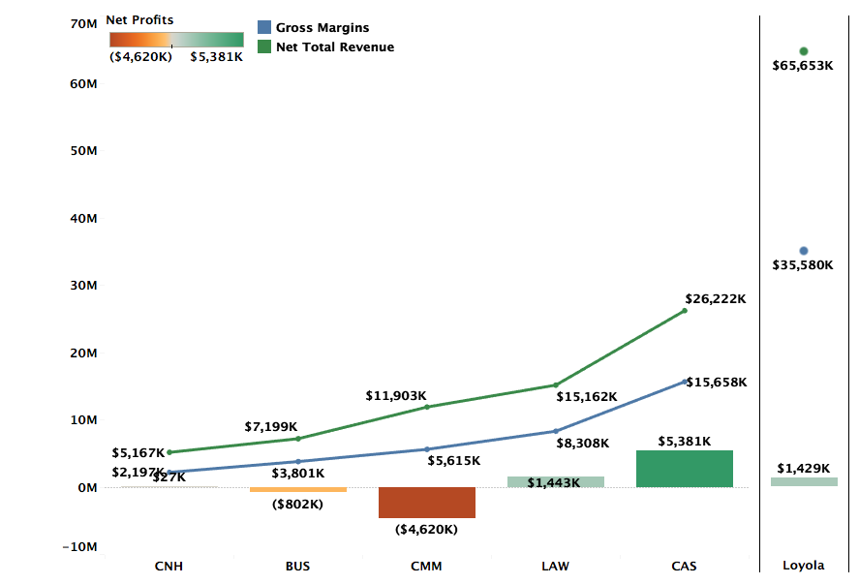
Profitability by College FY19 Actuals

Slide 29
Profitability by Department (FY19 Actuals)
Excluding Classical Studies and Environment
Notes:
Departments like Teacher Certification and Studio art are small departments with low costs. They have +ve gross margins but higher profitability largely because of dorm revenue share which is divided by college and within college, the departments get equal share.

Slide 30
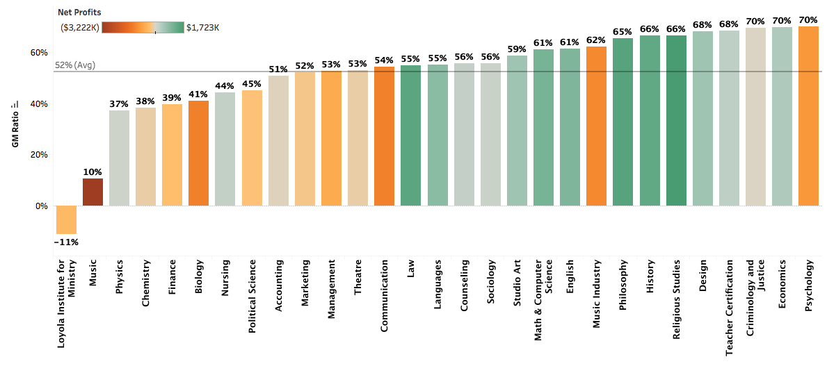
GM to Revenue Ratio by Department (FY19 Actuals)
Excluding Classical Studies and Environment

